Slide 1
MamaBot: A System Based on ML and NLP for Supporting Women and Families during Pregnancy

Slide 2
Objective
we focus on exploiting AI-based chatbot systems, mainly based on machine learning algorithms and Natural Language Processing, to understand and respond to needs of patients and their families.

Slide 3
Literature Survey
A systematic review of healthcare applications for smartphone
Many medical applications for smartphones have been developed and widely used by health professionals and patients. The use of smartphones is getting more attention in healthcare day by day. Medical applications make smartphones useful tools in the practice of evidence-based medicine at the point of care, in addition to their use in mobile clinical communication. Also, smartphones can play a very important role in patient education, disease self-management, and remote monitoring of patients.

Slide 4
Existing System
Artificial Intelligence has been widely applied to a majority of research areas, including health and medicine. Certain complications or disorders that can appear during pregnancy can endanger the life of both mother and fetus. There is enough scientific literature to support the idea that emotional aspects can be a relevant risk factor in pregnancy (such as anxiety, stress or depression, for instance). This paper presents a scoping review of the scientific literature from the past 12 years (2008-2020) to identify which methodologies, techniques, algorithms and frameworks are used in Artificial Intelligence and Affective Computing for pregnancy health and well-being

Slide 5
Problem Statement
we describe an application scenario for an AI-chatbot delivering support to pregnant women, mothers, and families with young children, by giving them help and instructions in relevant situations.

Slide 6
Proposed System
The methodology proposed by Arksey and O’Malley, in conjunction with PRISMA-ScR framework has been used to create this review. Despite the relevance that emotional status can have as a risk factor during pregnancy, one of the main findings of this study is that there is still not a significant amount of literature on automatic analysis of emotion. Health enhancement and well-being for pregnant women can be achieved with artificial intelligence or affective computing based devices, hence future work on this topic is strongly suggested

Slide 7
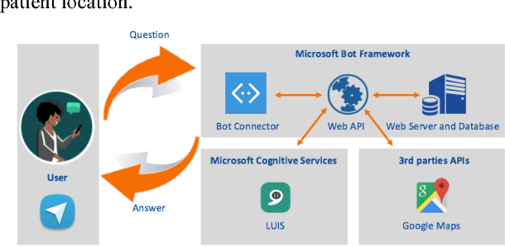
Architecture

Slide 8
Modules
User
Registration
Login
Question and Answers

Slide 9
REFERENCES
[1] B. Leeners, P. Neumaier-Wagner, S. Kuse, R. Stiller, and W. Rath, ‘‘Emotional stress and the risk to develop hypertensive diseases in pregnancy,’’ Hypertension Pregnancy, vol. 26, no. 2, pp. 211–226, Jan. 2007.
[2] G. Rejnö, C. Lundholm, S. Öberg, P. Lichtenstein, H. Larsson, B. D’Onofrio, K. Larsson, S. Saltvedt, B. K. Brew, and C. Almqvist, ‘‘Maternal anxiety, depression and asthma and adverse pregnancy outcomes—A population based study,’’ Sci. Rep., vol. 9, no. 1, pp. 1–9, Sep. 2019.
[3] T. Kurki, ‘‘Depression and anxiety in early pregnancy and risk for preeclampsia,’’ Obstetrics Gynecology, vol. 95, no. 4, pp. 487–490, Apr. 2000.

